Slide 2
What is climate change?
Climate change is caused by a long-term rise in global temperatures
This leads to shifts in weather patterns
Human activity is responsible for causing these changes

Slide 3
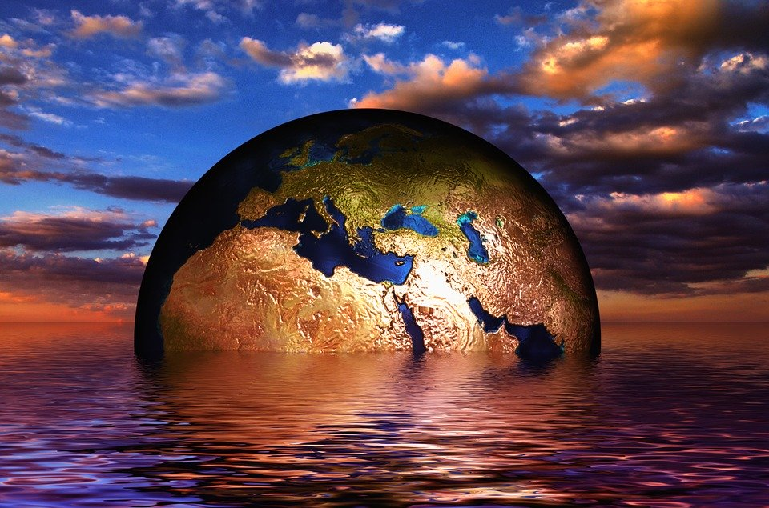
Notes:
https://pixabay.com/illustrations/earth-globe-water-wave-sea-lake-216834/

Slide 4
How does it work?
Human activity relies heavily on fossil fuels which release CO2 and other greenhouse gases
These gases get trapped as heat in the atmosphere
Increases have been huge in recent decades, driven mostly by mass consumption in wealthy countries

Slide 5
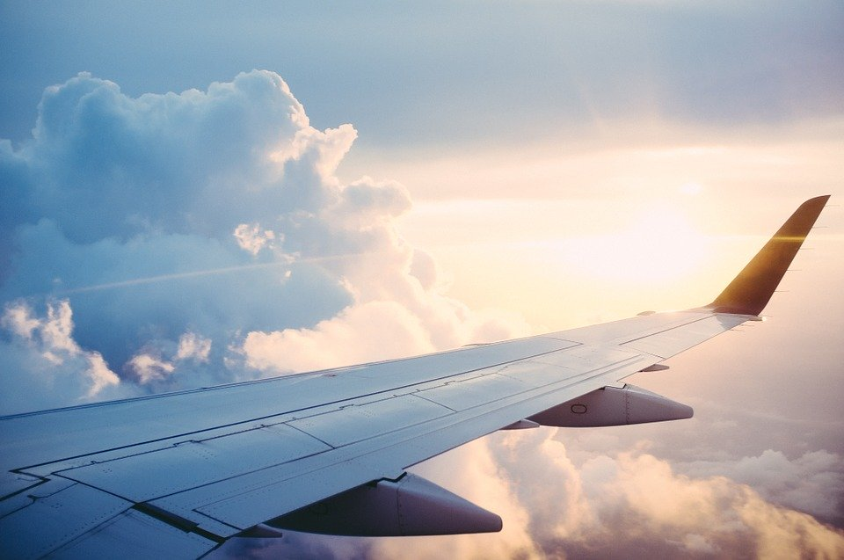
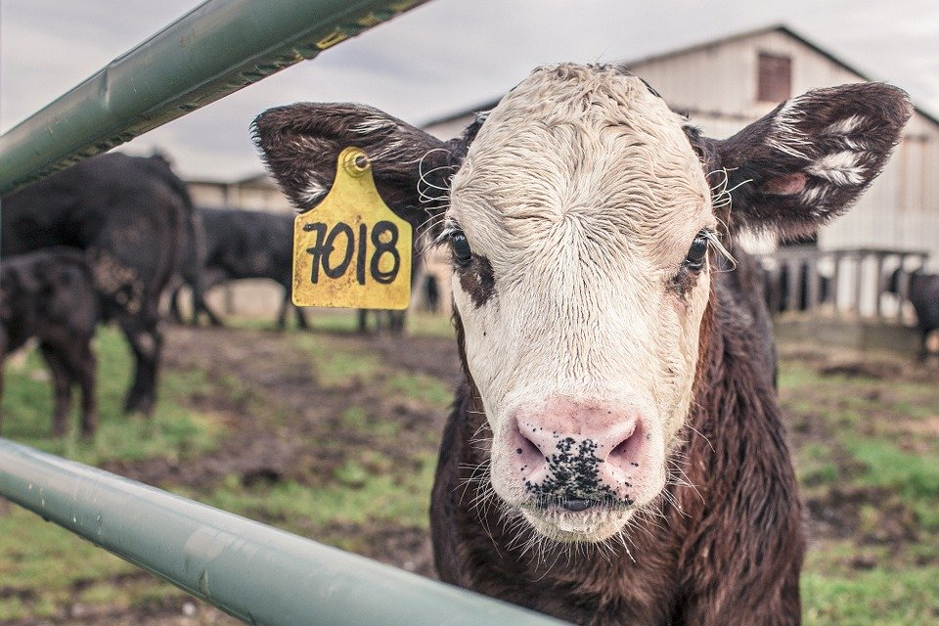
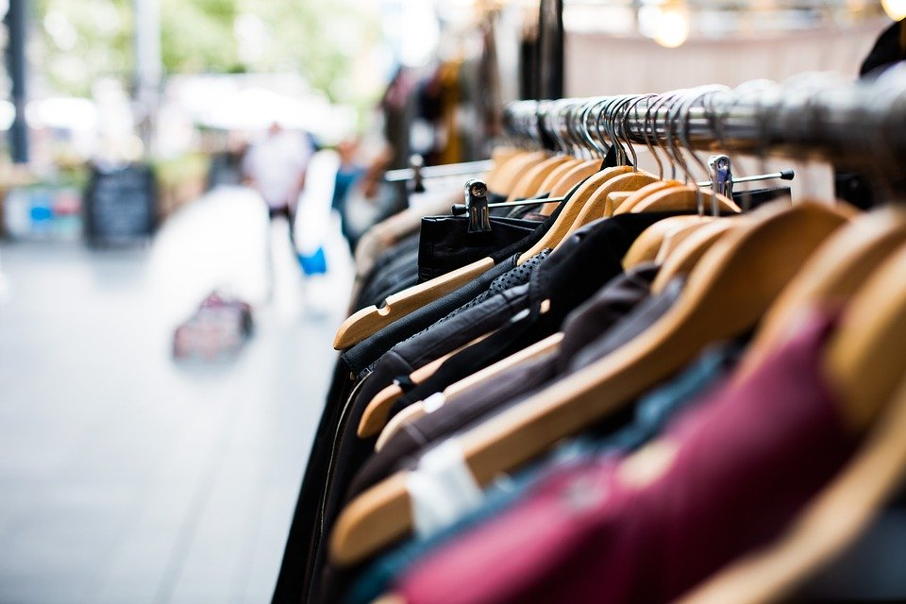
Notes:
https://pixabay.com/photos/calf-cow-maverick-farm-animal-farm-362170/(top right)
https://pixabay.com/photos/blur-hanger-clothing-shopping-1850082/ (bottom, left)
https://pixabay.com/photos/apple-macbook-business-1867762/ (bottom, right)
https://pixabay.com/photos/plane-trip-journey-explore-841441/ (top left)

Slide 6
An unfair system?
The effects of mass consumption and climate change are unevenly distributed
Populations in the wealthy countries are responsible for the majority of global emissions
But, populations in the poorer countries are exposed to the majority of the consequences

Slide 7
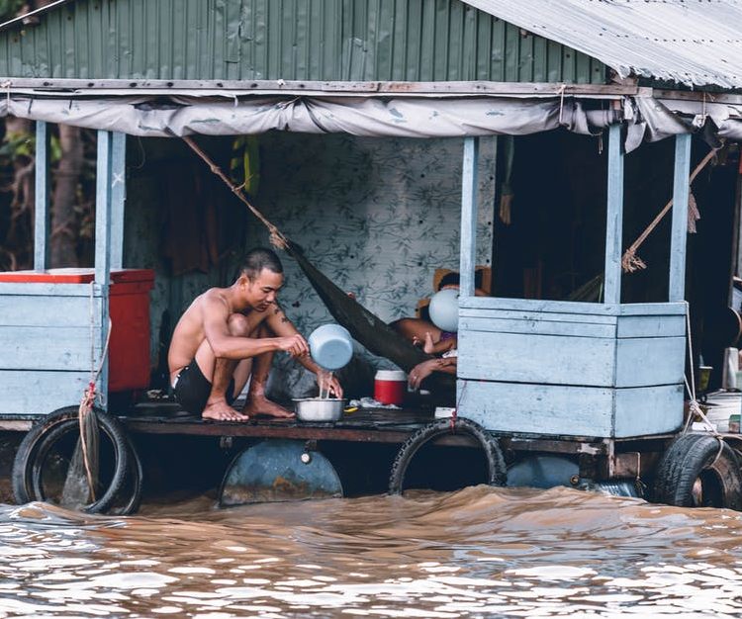
An unfair system?
Notes:
https://www.pexels.com/photo/adult-beautiful-elegant-eyewear-291762/
https://www.pexels.com/photo/man-pouring-water-from-dipper-on-blue-and-grey-house-1739855/

Slide 8
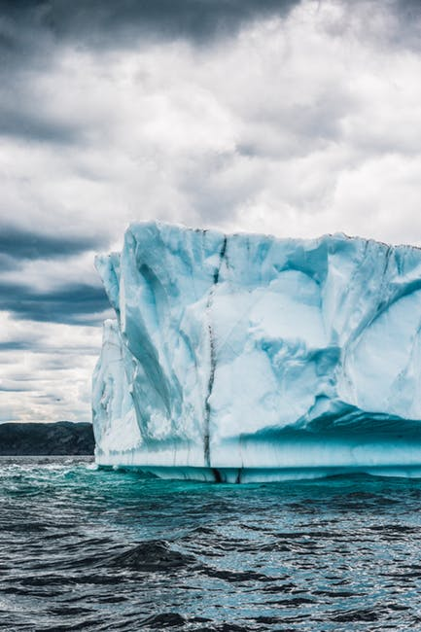
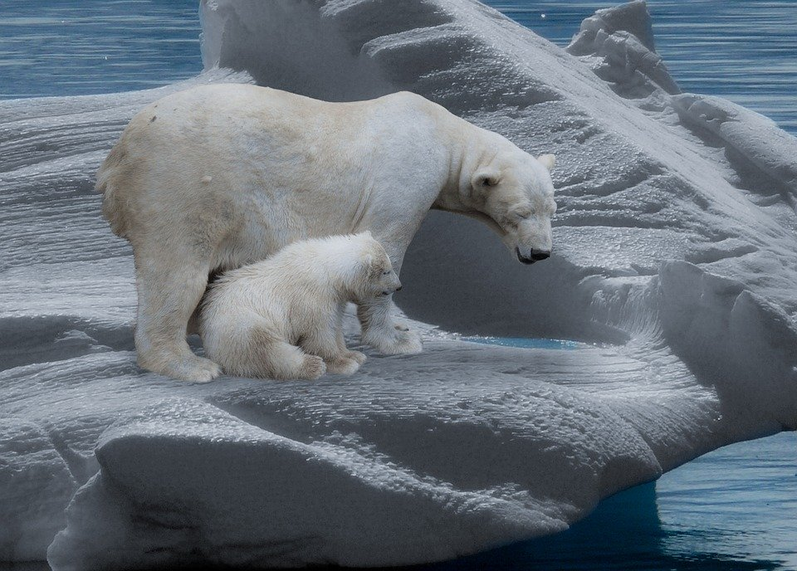
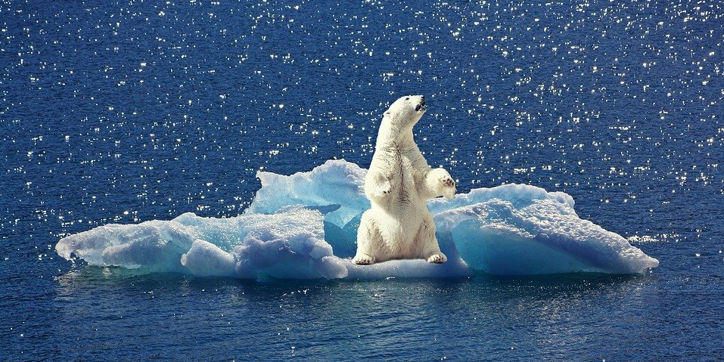
Notes:
https://pixabay.com/photos/polar-bear-polar-bears-predator-709682/ (top right)
https://pixabay.com/photos/polar-bear-iceberg-ice-floe-2199534/ (bottom right)
https://www.pexels.com/photo/white-ice-formation-2869610/ (left)

Slide 9
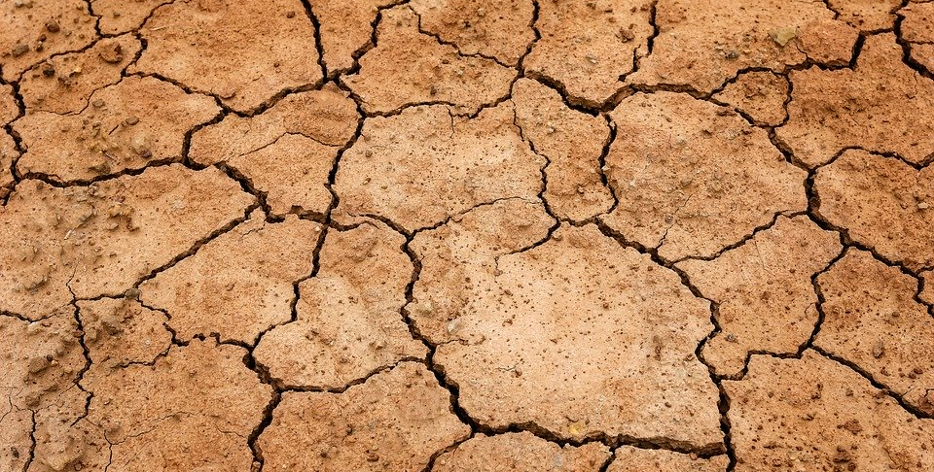
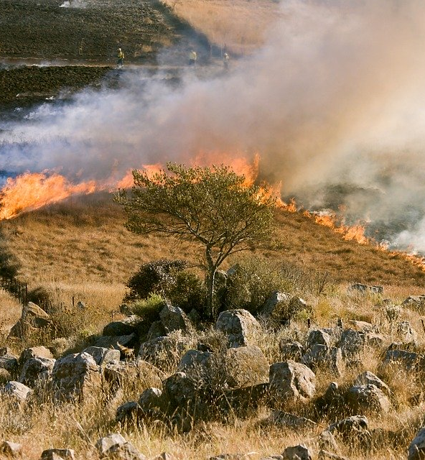
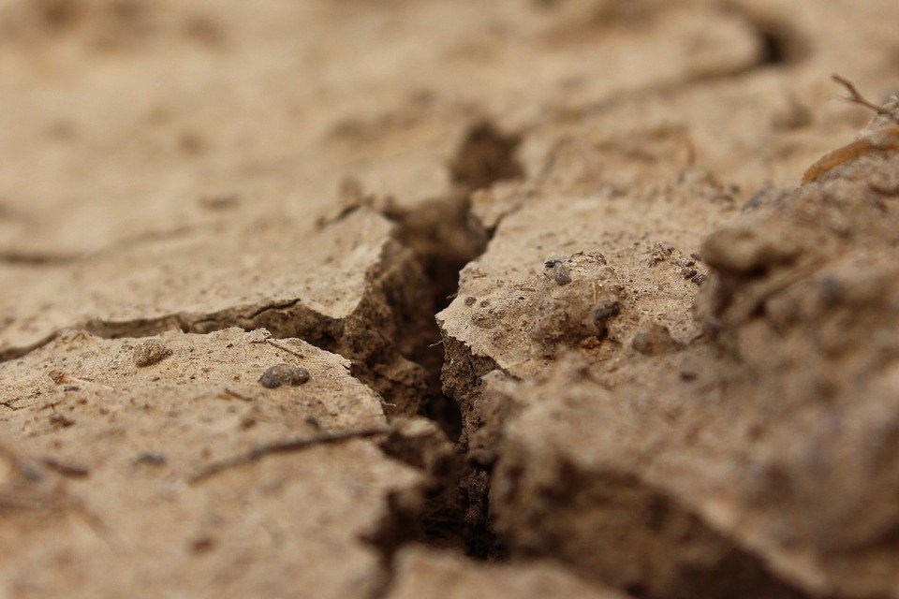
Notes:
https://pixabay.com/photos/earth-drought-ground-dehydrated-3355931/ (top, left)
https://pixabay.com/photos/crack-land-drought-soil-dry-clay-995370/ (bottom left)
https://pixabay.com/photos/grass-fire-firefighter-smoke-807388/ (right)

Slide 10
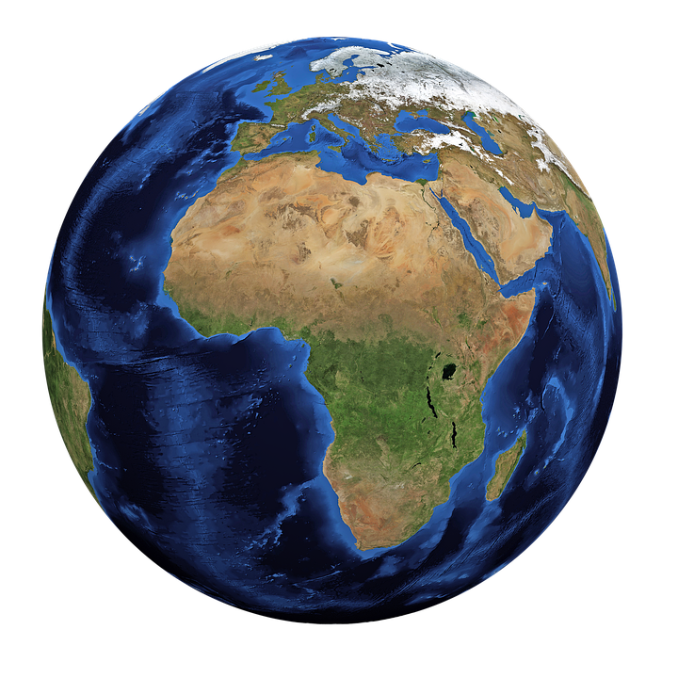
Temperature rise
1.5°C
4°C
Notes:
https://pixabay.com/illustrations/world-globe-earth-planet-blue-1303628/

Slide 11
Temperature rise
It is impossible to predict exactly what will happen
Many experts say even 2°C rise would be dangerous
Rises above 4°C may lead to irreversible damage
This might include…
Biodiversity loss
More frequent extreme weather
Loss of human population

Slide 12
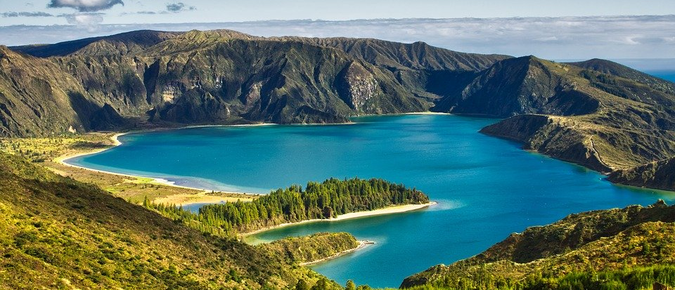
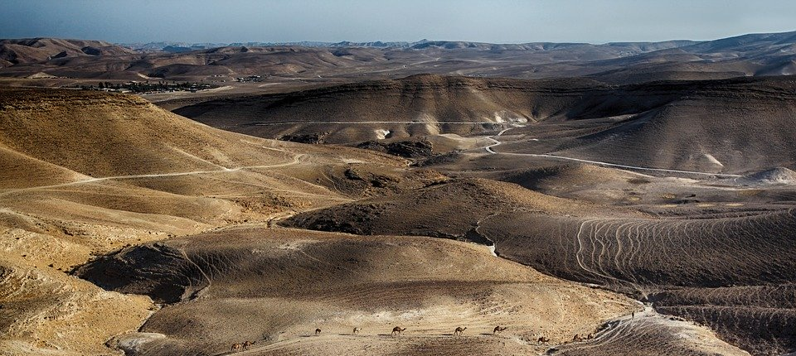
Notes:
https://pixabay.com/photos/nature-landscape-lake-of-fire-3595382/
https://pixabay.com/photos/dead-sea-caravan-camel-red-brown-1930735/

Slide 13
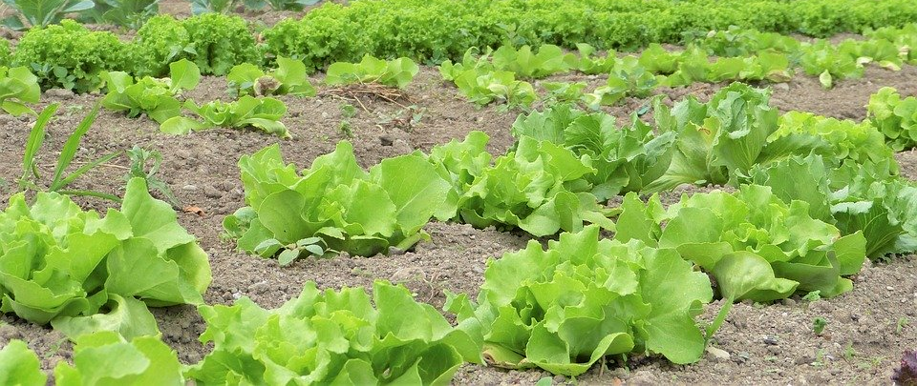
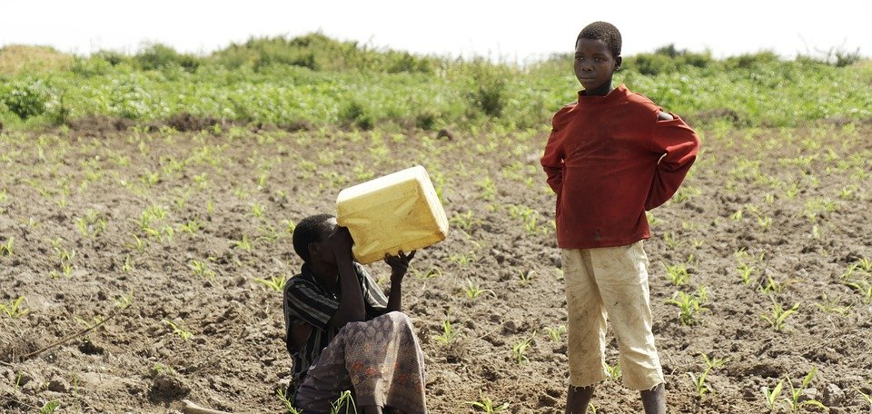
Notes:
https://pixabay.com/photos/village-people-in-uganda-uganda-2665014/ (bottom)
https://pixabay.com/photos/salad-herbs-vegetables-cultivation-2482457/ (top)

Slide 14
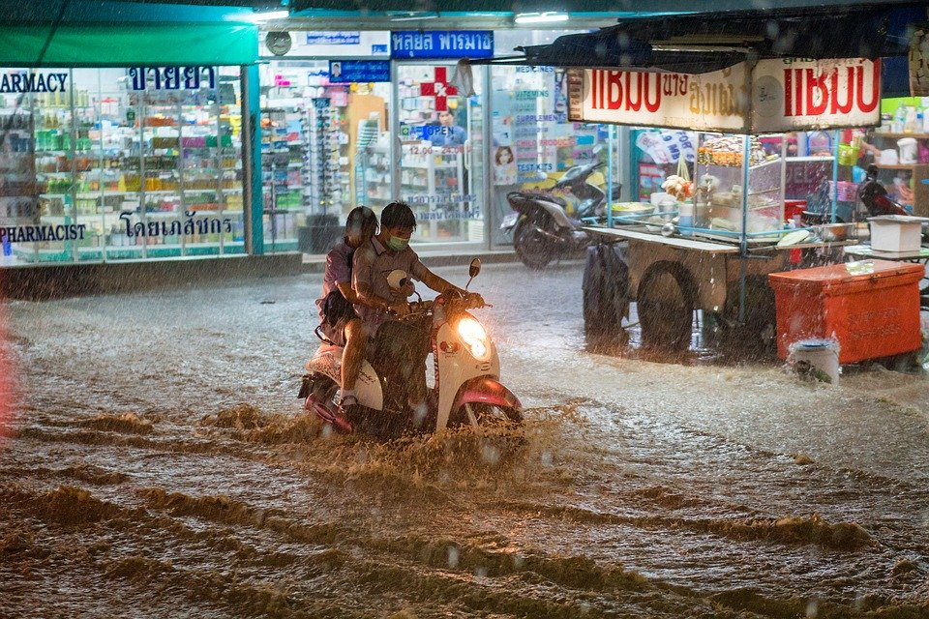
Notes:
https://pixabay.com/photos/rain-heavy-flood-extreme-weather-2085065/

Slide 15
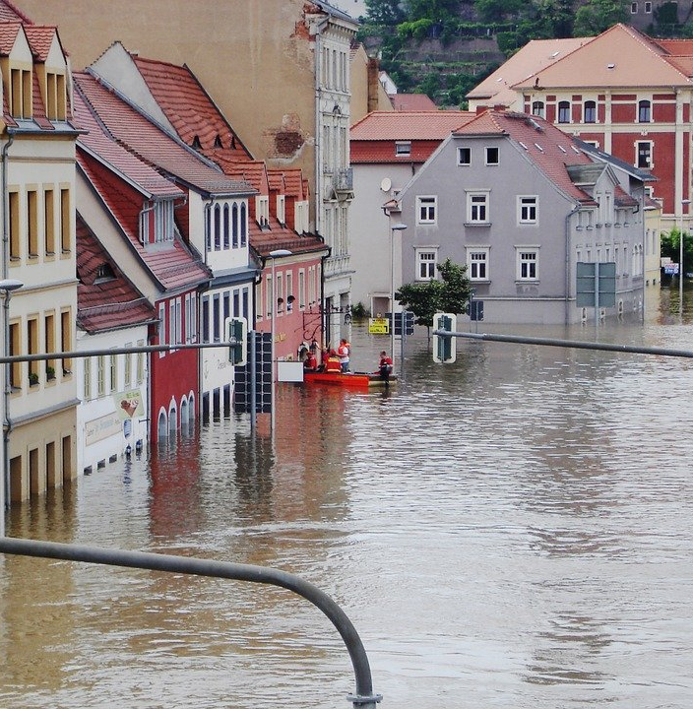
Notes:
https://pixabay.com/photos/high-water-shield-setting-water-392707/ (right)
https://pixabay.com/photos/high-water-elbe-meissen-emergency-876580/ (left)

Slide 16
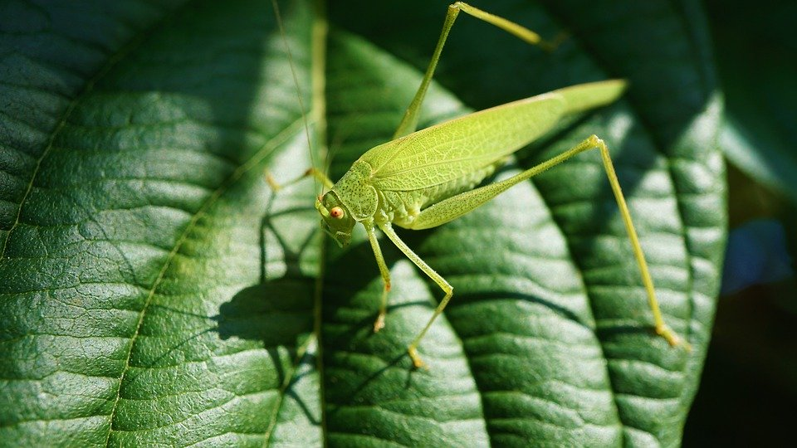
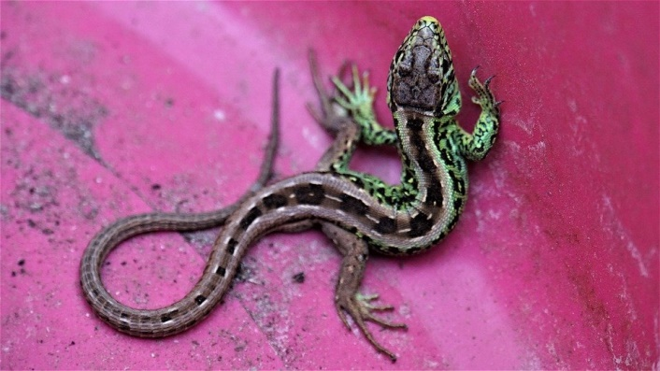
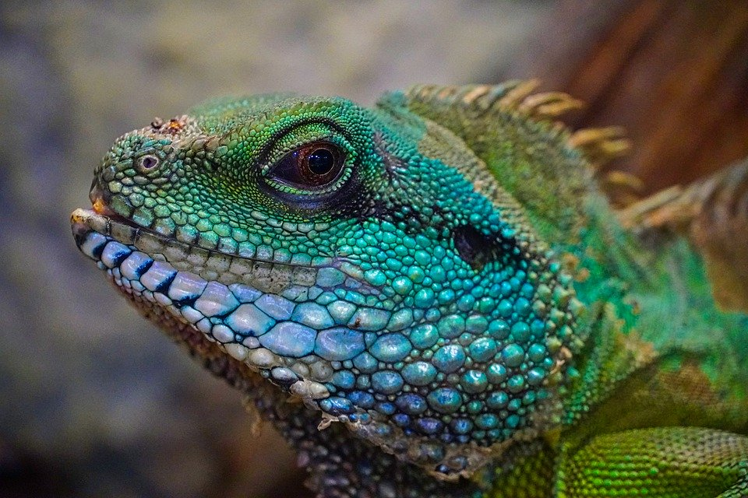
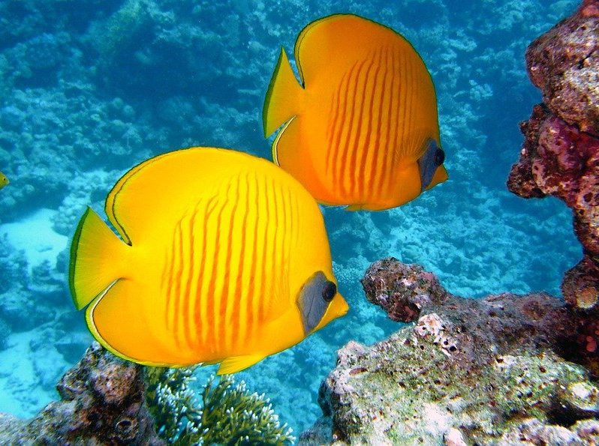
Notes:
https://pixabay.com/photos/grasshopper-viridissima-insect-4493129/ (top left)
https://pixabay.com/photos/lizard-reptile-salamander-gecko-4291013/ (top centre)
https://pixabay.com/photos/lizard-colorful-head-view-exotic-4763351/ (bottom right)
https://pixabay.com/photos/butterfly-wings-tropical-brown-316740/ (top right)
https://pixabay.com/photos/zitronenfalter-fish-fish-exotic-380037/ (bottom left)

Slide 17
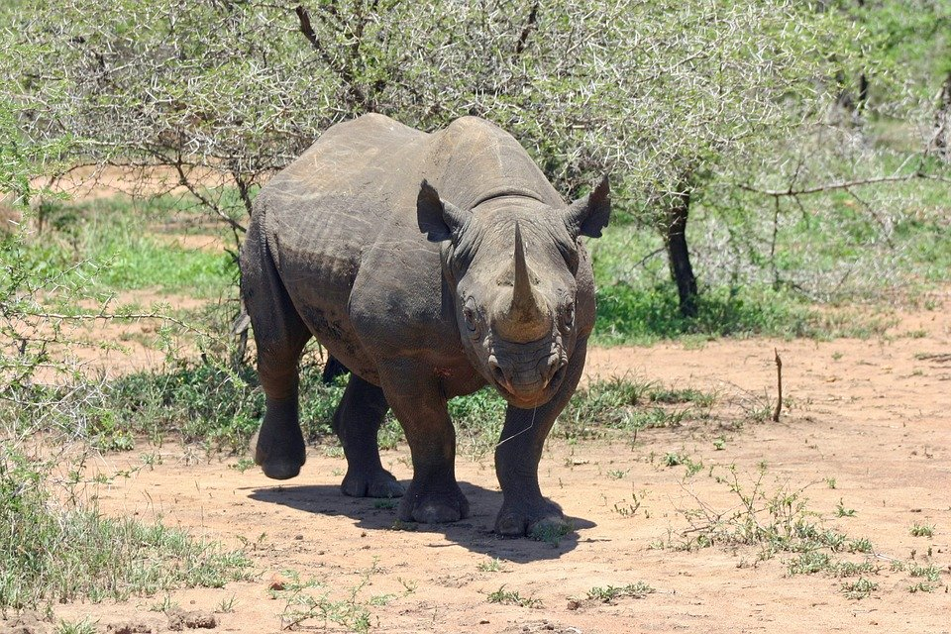
Threatened species include…
Notes:
Black rhino
https://pixabay.com/photos/black-rhinoceros-rhinoceros-rhino-412667/

Slide 18
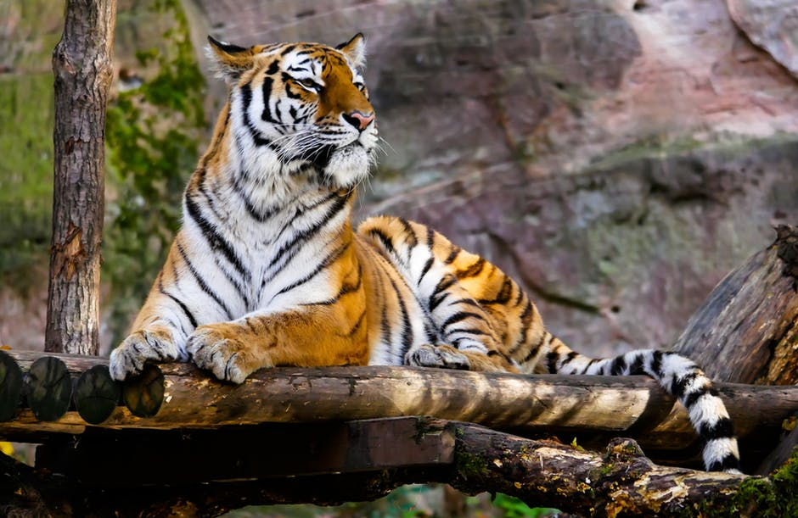
Threatened species include…
Notes:
Sunda tiger
https://www.pexels.com/photo/animal-big-cat-jungle-safari-236601/

Slide 19
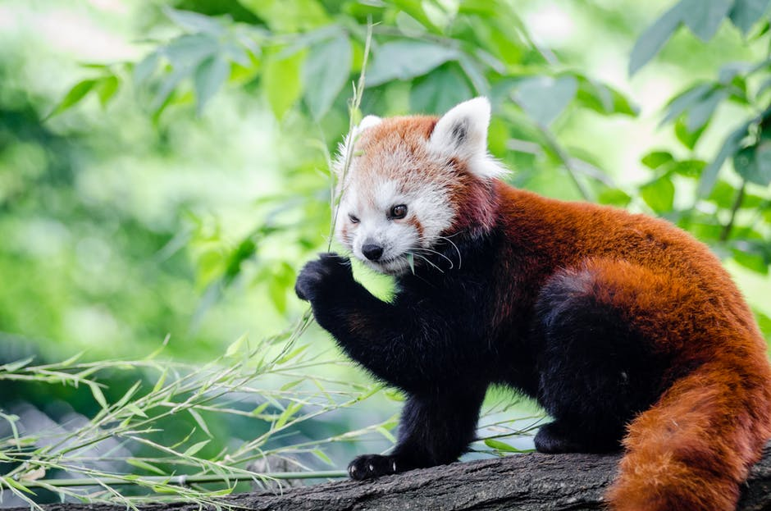
Threatened species include…
Notes:
Red panda
https://www.pexels.com/photo/brown-and-white-bear-on-tree-branch-during-daytime-148132/

Slide 20
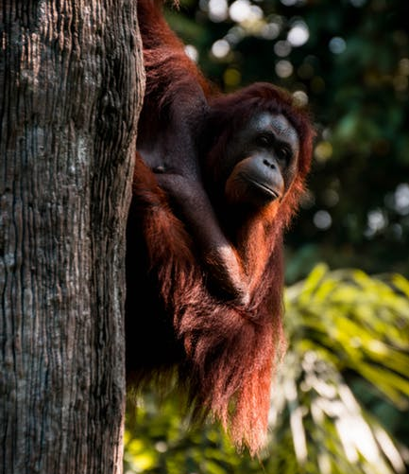
Threatened species include…
Notes:
Orangutan
https://www.pexels.com/photo/orangutan-clinging-on-tree-2411914/

Slide 21
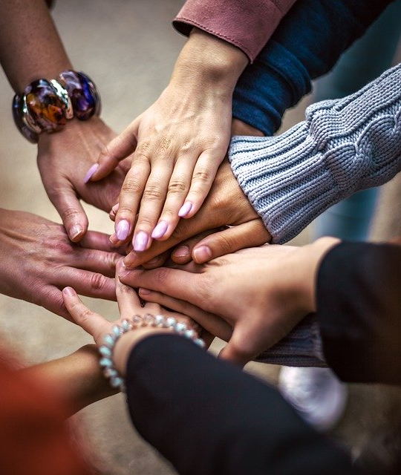
Solutions
Individual level action is important – but, we also need to act collectively
Together, we can create more pressure to make sure that governments and businesses are doing their fair share
Notes:
https://pixabay.com/photos/team-friendship-group-hands-4529717/

Slide 22
How can we help?
Tell governments and corporations to act now!
Send an email to your local MP or to a business you buy from – ask them what they are doing to help achieve our climate targets
Notes:
https://www.pexels.com/photo/email-blocks-on-gray-surface-1591062/

Slide 23
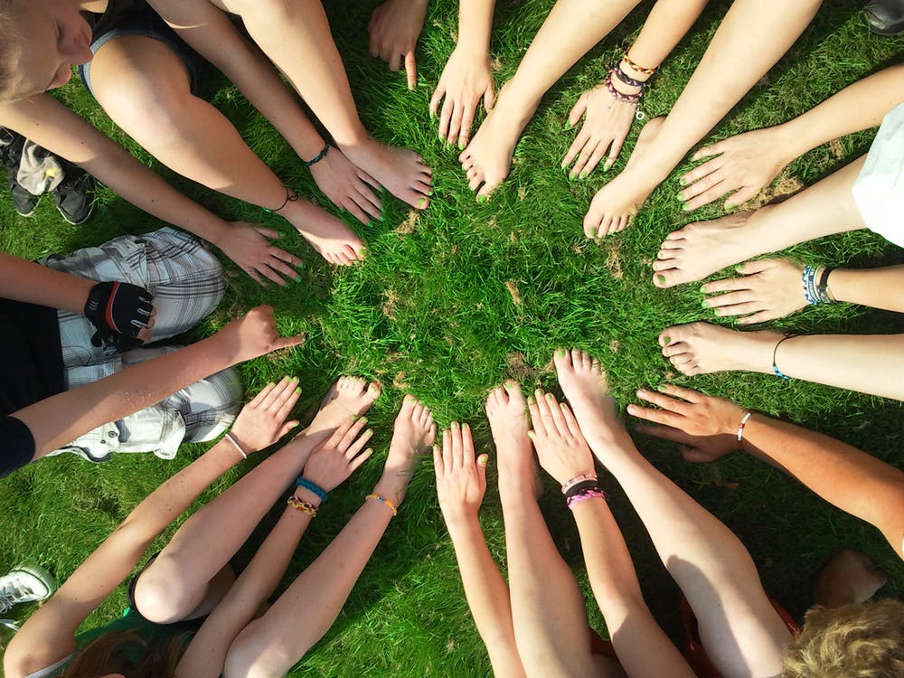
How can we help?
Get involved with your community
Meet with local environmental groups
Organise an action with family or friends
Notes:
https://www.pexels.com/photo/person-gather-hand-and-foot-in-center-53958/ (left)
https://www.pexels.com/photo/people-coffee-meeting-team-7096/ (right)
https://www.pexels.com/photo/person-holding-clear-plastic-bottle-3480494/ (centre)

Slide 24
How can we help?
Be the change you want to see
We know that flying, fast fashion and eating meat are some of the most polluting and harmful activities for our planet
Do your best to reduce your impact and consumption where you can

Slide 25
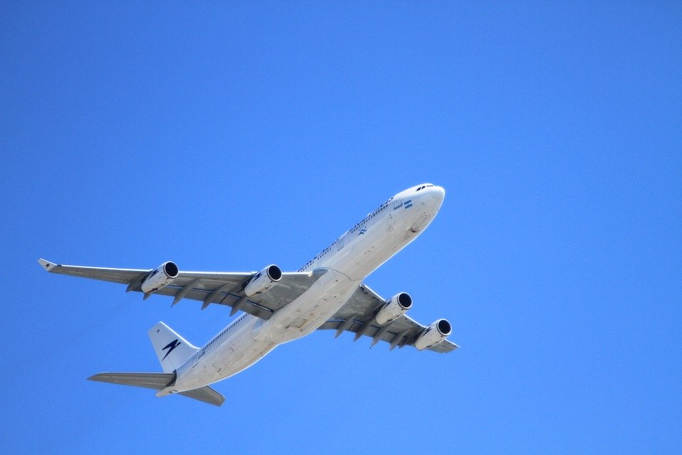
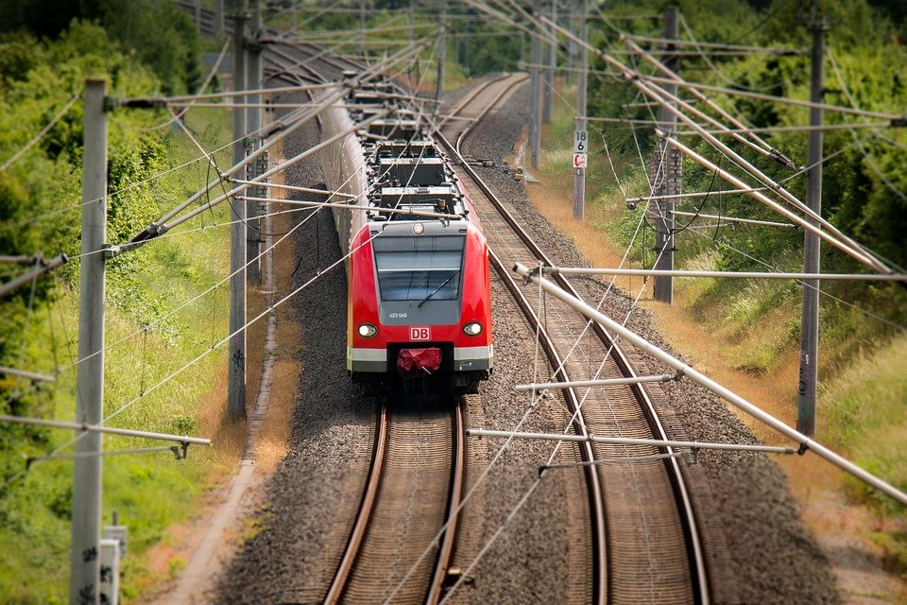
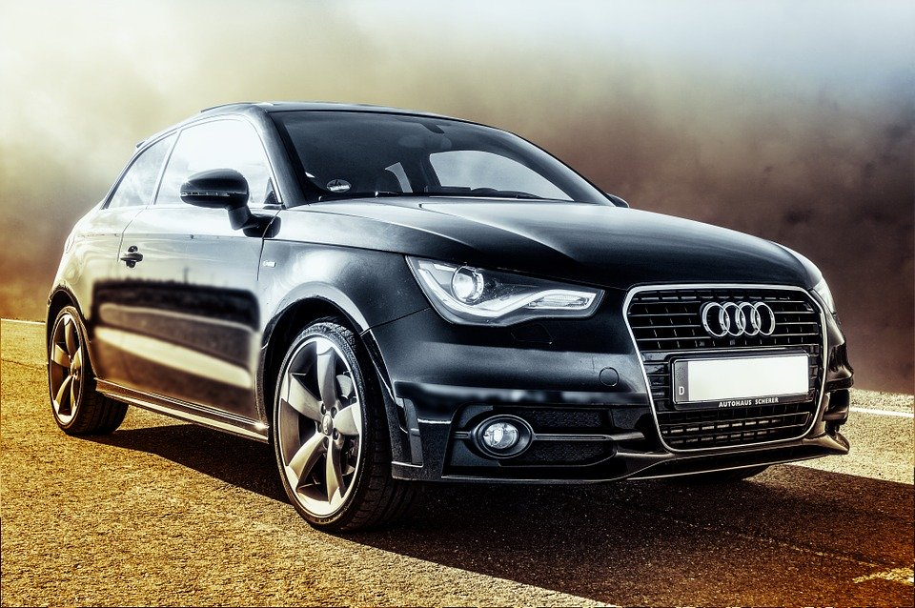
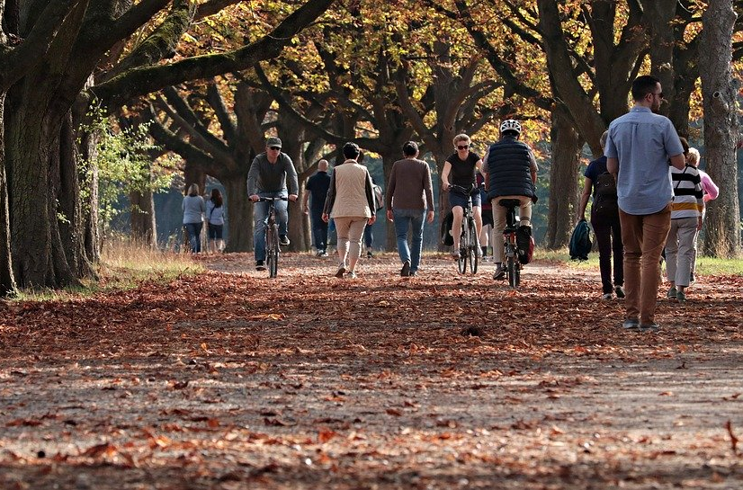
Notes:
https://pixabay.com/photos/plane-aircraft-take-off-sky-50893/ (top left)
https://pixabay.com/photos/car-audi-auto-automotive-vehicle-604019/ (bottom left)
https://pixabay.com/photos/train-railway-s-bahn-transport-797072/ (top right)
https://pixabay.com/photos/walk-tree-lined-avenue-nature-away-3731094/ (top left)

Slide 26
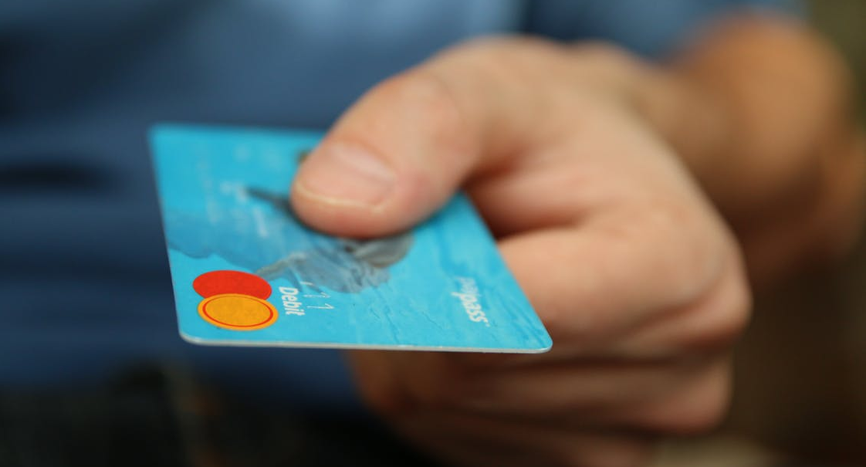
Notes:
https://images.pexels.com/photos/50987/money-card-business-credit-card-50987.jpeg?cs=srgb&dl=shopping-business-money-pay-50987.jpg&fm=jpg (bottom left)
https://www.pexels.com/photo/shopping-bags-5957/ (right)
https://www.pexels.com/photo/background-bags-black-buy-346752/ (top left)

Slide 27
Notes:
https://www.pexels.com/photo/flat-lay-photography-of-vegetable-salad-on-plate-1640777/

Slide 28
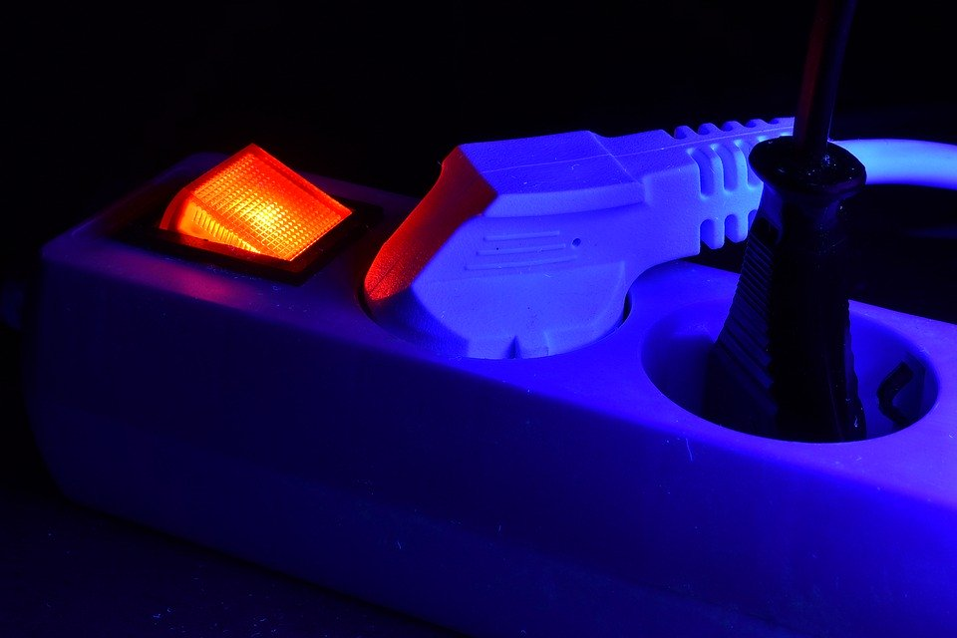
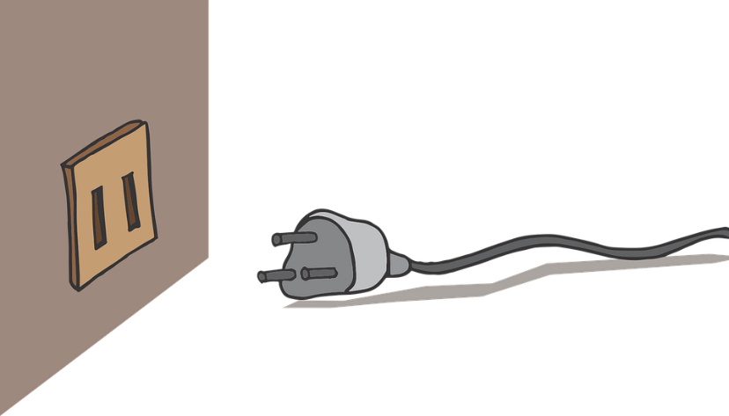
How can we help?
Remember to power off electronics (at the plug!) when you are not using them
Get a smart meter in your house to monitor how much energy you are using
Notes:
https://pixabay.com/photos/connection-plug-socket-cables-4821773/ (left)
https://pixabay.com/illustrations/plug-socket-wall-electric-power-1459663/ (right)
https://pixabay.com/vectors/switch-light-off-position-panel-36000/ (centre)

Slide 29
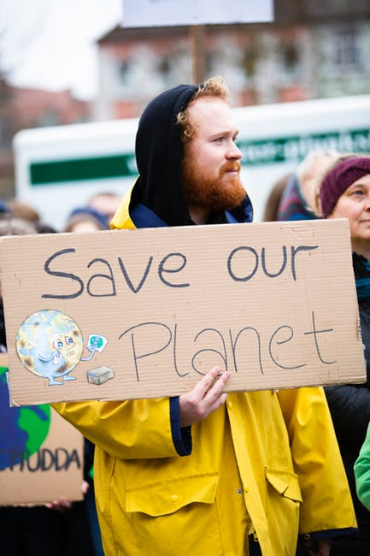
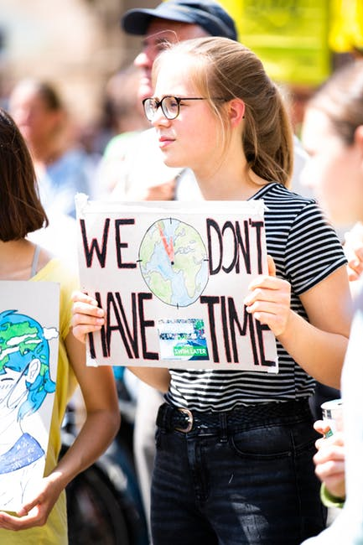
Remember we are part of a global movement calling for change!
Notes:
https://www.pexels.com/photo/climate-man-people-street-2027058/ (left)
https://www.pexels.com/photo/climate-cold-road-landscape-2559747/ (right)
https://pixabay.com/photos/climate-protest-demo-protest-action-455713/ (centre)

Slide 30
This powerpoint has been produced by Leeds DEC as part of a bigger World Class Teaching project. Visit www.globalschools.org.uk for free lessons and materials for your teacher to download.

